Slide 1
Mid-Term Project
-Insights of Bike Buyers
June 24, 2023 Jagunmolou Odebamike & Jennifer Zhao

Slide 2
Overview
This bike buyer dataset includes individuals' demographic attributes (marital status, gender, age, and children), financial status (income and home ownership), education, occupation, number of cars, commute distance, region, and whether they purchased a bike or not.
our project goal is to find whether is there any column or all columns that have a connection or causation to the “Purchased bike” column. Make valuable insights for companies in the bike industry to better understand their customers and improve their marketing and product strategies.

Slide 3
Limitations
Small Sample Size: One of the main limitations of this analysis is the small sample size of the dataset. With a limited number of data points, the findings and insights derived from the analysis may not be fully representative of the broader population.
Missing Variables: The dataset lacks certain variables that could be relevant to bike purchasing decisions. For example, information on individuals' interests in outdoor activities, health and fitness habits, or environmental concerns could provide valuable insights into their motivation to buy a bike. The absence of these variables limits the comprehensive understanding of the factors influencing bike purchases.
External Factors: The analysis does not account for external factors that may influence bike purchasing decisions, such as local infrastructure (e.g., bike lanes, bike-sharing programs), cultural or social norms, or economic factors (e.g., inflation, recessions) that could impact individuals' willingness or ability to buy bikes.

Slide 4
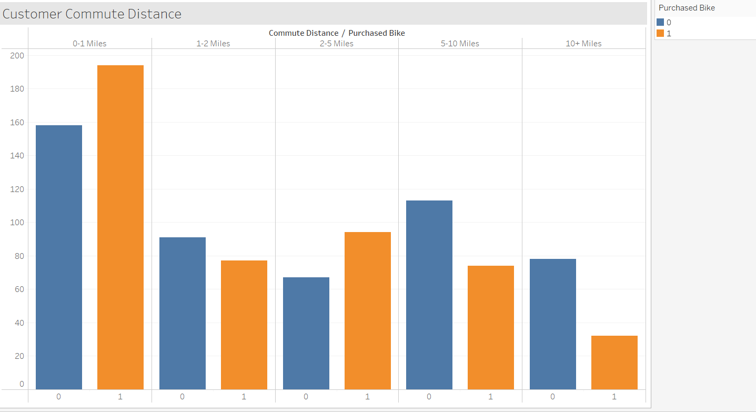
Findings and insights
In lower distances number of purchased people is more than other.

Slide 5
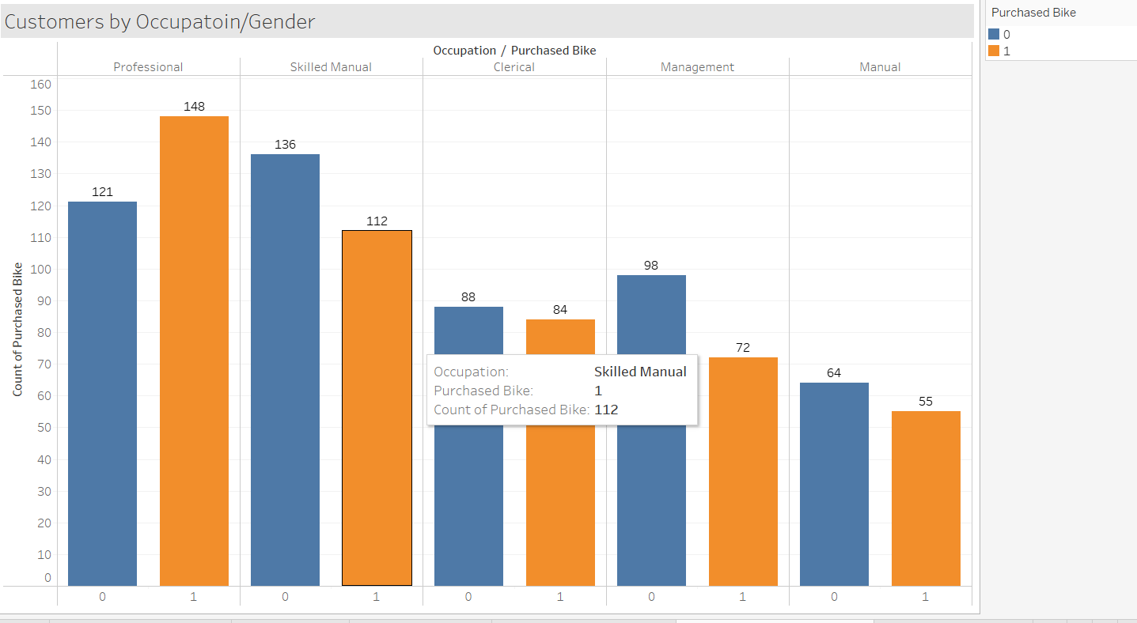
Findings and insights
We can see Occupation professional ones purchased more than others

Slide 6
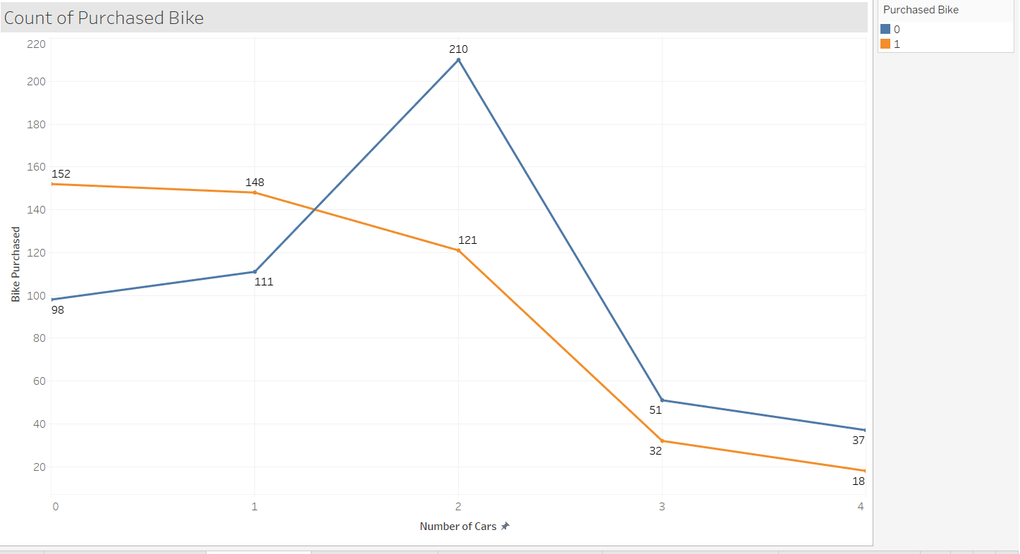
Findings and insights
From this chart, we can say people who has less car purchased more.

Slide 7
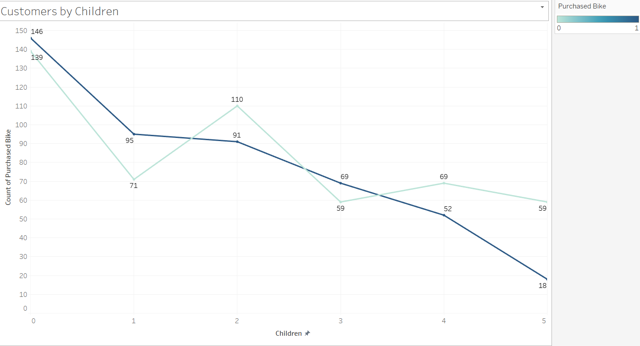
Findings and insights
People who have fewer children purchased more.

Slide 8
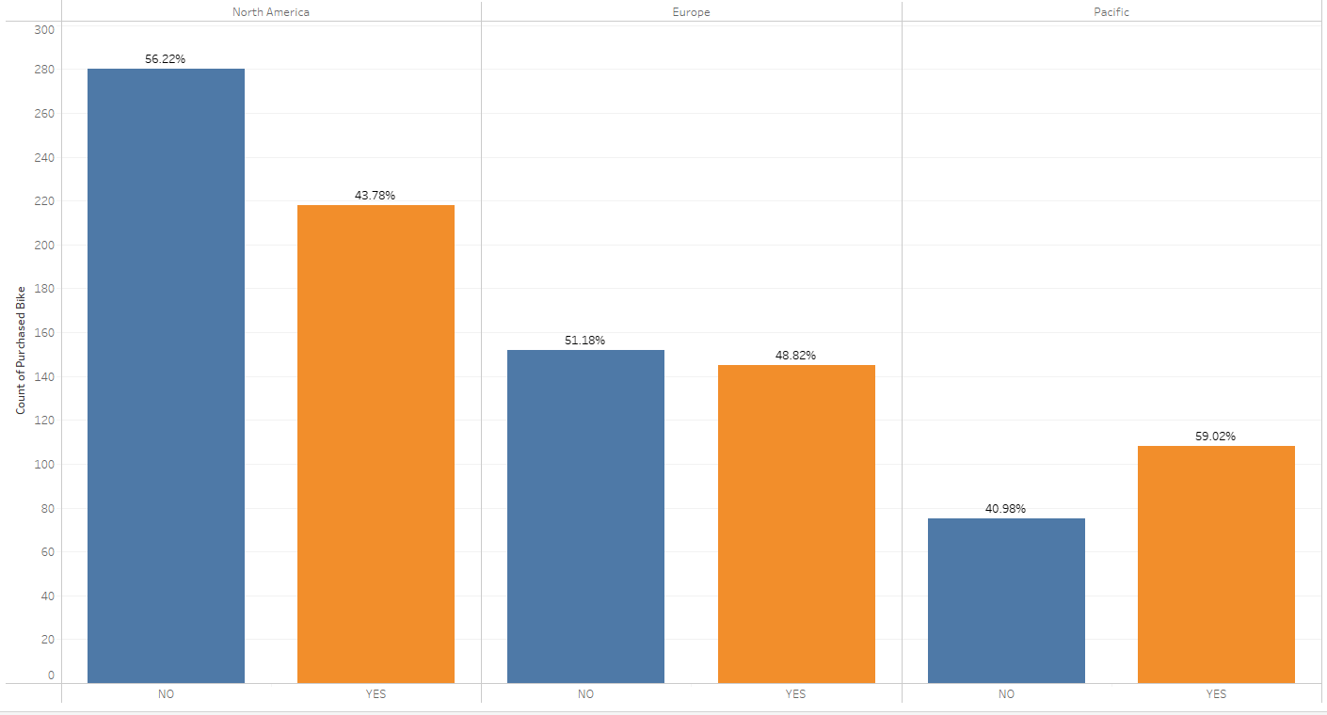
Findings and insights
In North America, the number of purchased bikes is the highest, while the ratio of people who own a bike is slightly lower. On the other hand, in Europe, the ratio of people who own a bike is the highest.

Slide 9
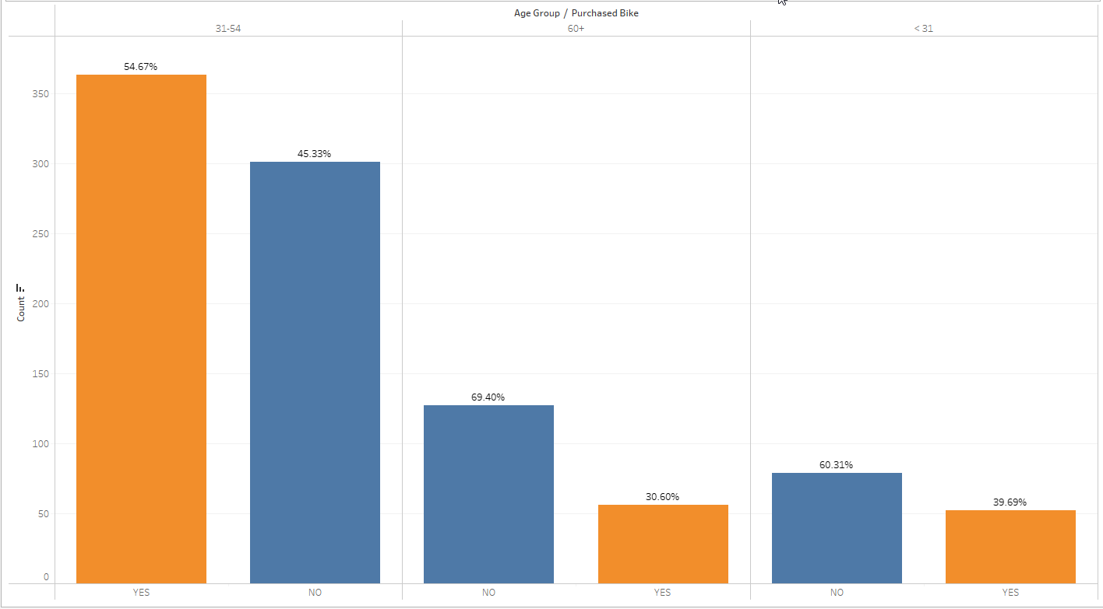
Findings and insights
the chart demonstrates variations in bike ownership across different age groups.
For the age group between 31 and 54, bike ownership is relatively common within this age range.
For the age group over 60, bike ownership decreases as individuals get older.
Within the adult age group below 31, bike ownership is somewhat lower among younger adults.

Slide 10
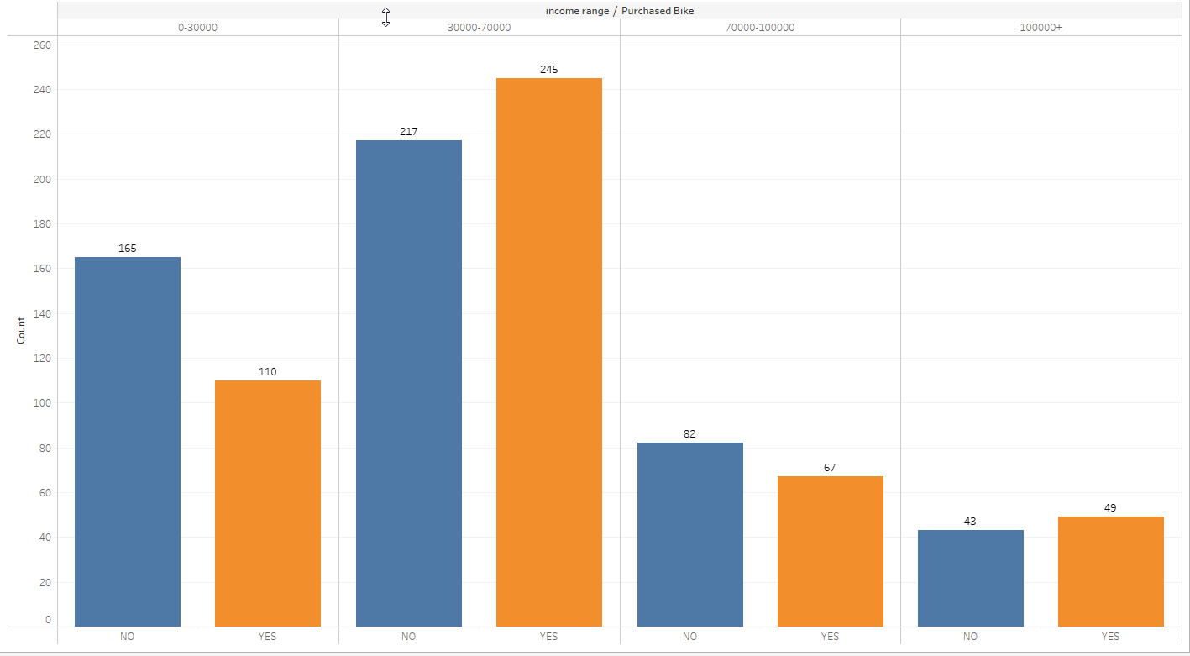
Findings and insights
this chart highlights the relationship between income levels and bike ownership. It reveals that in the middle-income range of 30,000 – 70,000, a significant portion of individuals own bikes. However, as we move up the income ladder, the number of bike owners tends to decrease slightly. Nonetheless, even in higher income brackets, there are individuals who choose to own bikes.

Slide 11
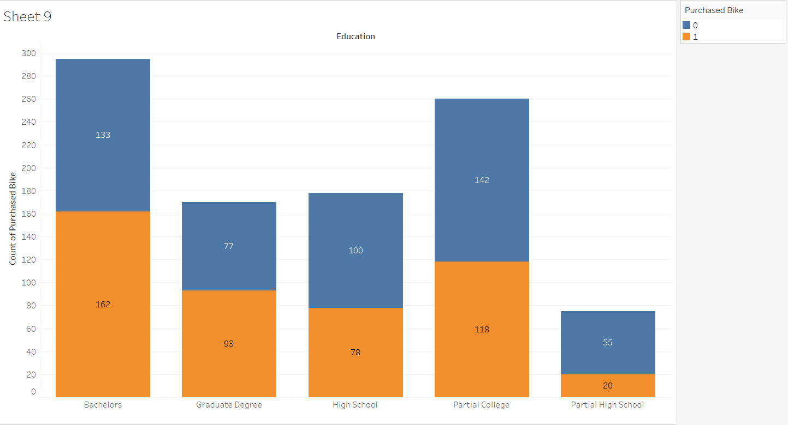
Findings and insights
Based on the chart, it is evident that among individuals with bachelor's and graduate degrees, over 50% own a bike. However, for the remaining three groups, the percentage of bike owners is comparatively lower.

Slide 12
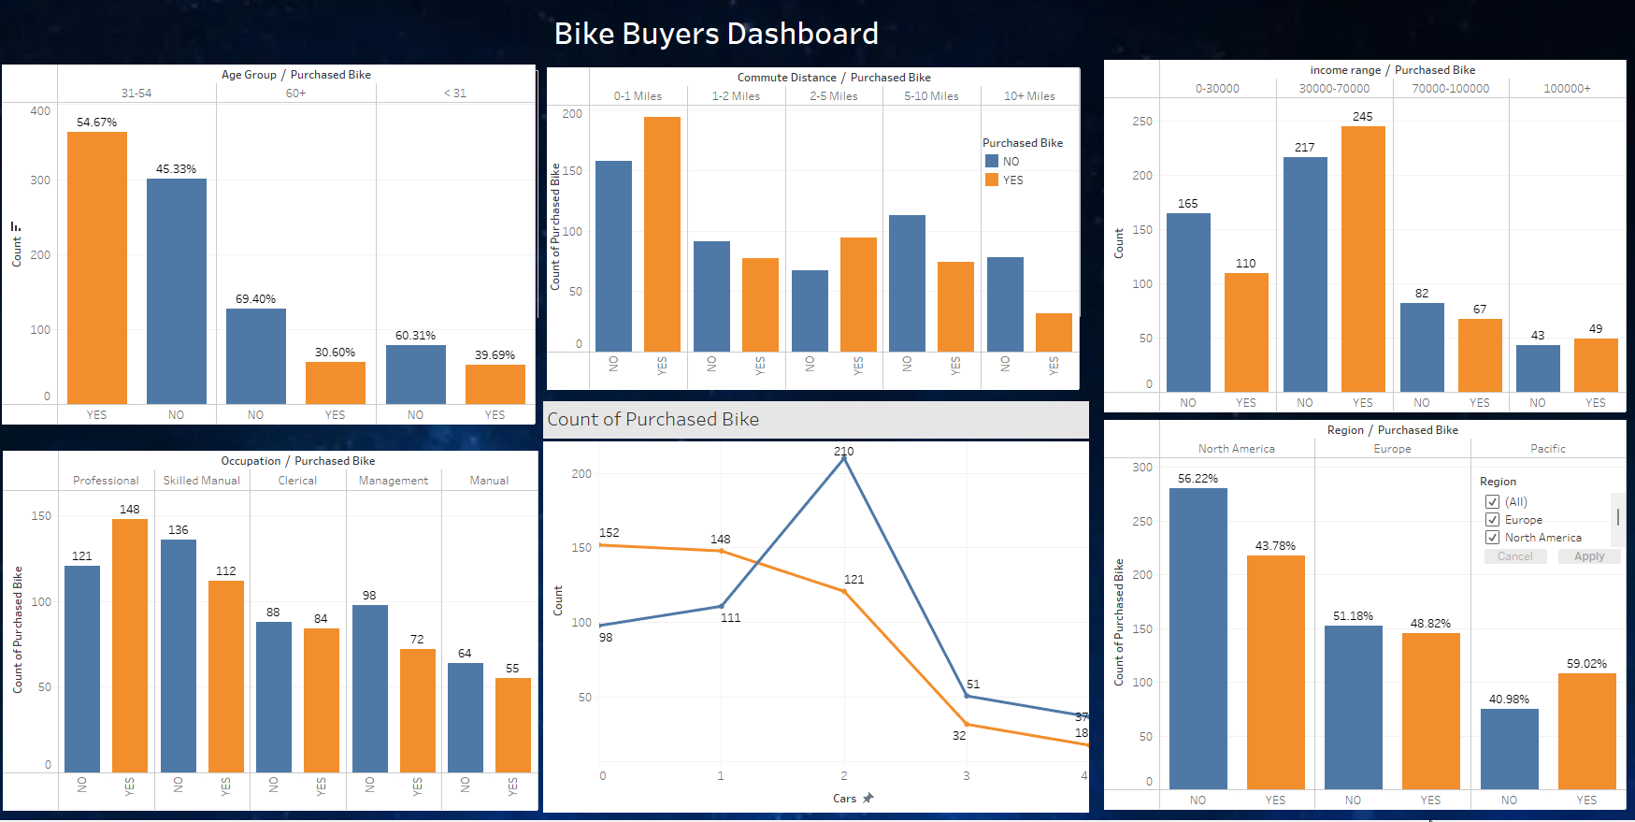
Findings and insights
In N

Slide 13
Challenges
The challenges we faced in the project were primarily related to the dataset, which differed from previous ones we had worked with. One significant issue was the limited amount of information available for analysis, as we only had data pertaining to the specific column - purchased bike. As a result, all the charts produced seemed to exhibit a similar and unimpressive appearance.
If we have more time, we’ll change the dataset to analyze.

Slide 14
Key Insights and Recomendations
By targeting specific demographics and adapting to market trends, bike retailers and marketers can enhance their ability to attract and retain customers in a competitive market. Recommendations for bike retailers or marketers based on the insights are as follows:
Target Specific Demographic Groups: Focus marketing efforts on middle-aged individuals who have fewer children and less cars, as they may have more time and disposable income for leisure activities like biking.
Consider targeting individuals with higher levels of education, as they may value the health and environmental benefits of cycling.
Emphasize Professional Occupations: Tailor marketing messages and campaigns towards individuals with professional occupations, as they may have higher purchasing power and be more inclined to invest in quality bikes and accessories.
Highlight Commute-Friendly Features: Promote bikes that are suitable for shorter commutes, emphasizing their convenience, eco-friendliness, and potential cost savings compared to other modes of transportation.

Slide 15

Thank you!

